Slide 1
Data Representation & Boolean Algebra

Slide 2
Number system
Different Number system
Base / Radix
MSD / LSD
Number Conversion
Binary Arithmetic
Representation of Numbers
Representation of Characters
Boolean Algebra
Demorgan’s Theorm

Slide 3



Number system
Systematic way to represent numbers in different ways
Hello world
01001000 01100101 01101100 01101100 01101111 00100000 01110111 01101111 01110010 01101100 01100100
72 101 108 108 111 32 87 111 114 108 100

Slide 4
Different types of Number system
Binary Number system
0, 1
Octal Number system
0, 1, 2, 3, 4, 5, 6, 7
Decimal Number system
0, 1, 2, 3, 4, 5, 6, 7, 8, 9
Hexadecimal Number system
0, 1, 2, 3, 4, 5, 6, 7, 8, 9,
A, B, C, D, E, F

Slide 5
Base / Radix
The number of symbols used in a number system is called Base / Radix of a number system
Eg. (1301)
8

Slide 6
Identify the number system
(1102)
16
Hexadecimal
(1101)
10
Decimal
(6327)
8
Octal

Slide 7
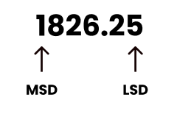
MSD & LSD
MSD : Left most digit of a number is called MSD
( Most Significant Digit )
LSD : Right most digit of a number is called LSD
( Least Significant Digit )

Slide 8
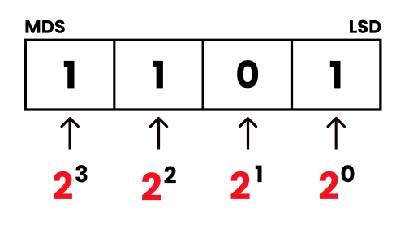

- Binary Number system
Base : 2
Symbols : 0 1
Also called BIT
Eg : (1101)
Position Representation
2

Slide 9
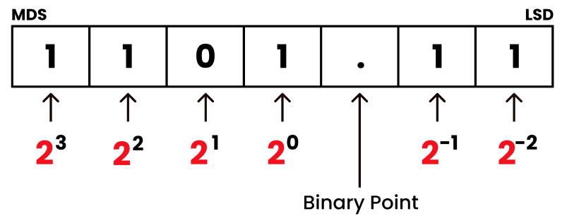
- Binary Number system
Eg : (1101.11)
Position Representation
2

Slide 10
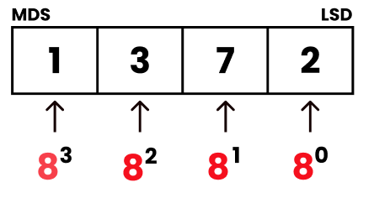
- Octal Number system
Base : 8
Symbols : 0 1 2 3 4 5 6 7
Eg : (1372)
Position Representation
8

Slide 11
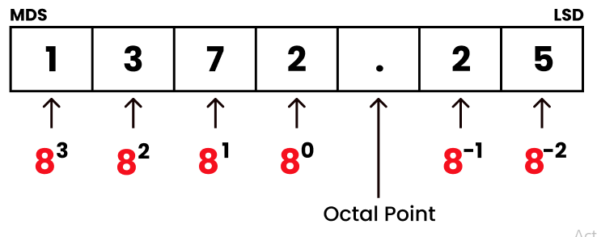
- Octal Number system
Eg : (1372 . 25)
Position Representation
8

Slide 12
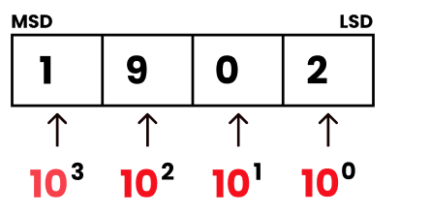
- Decimal Number system
Base : 10
Symbols : 0 1 2 3 4 5 6 7 8 9
Eg : (1902)
Position Representation
10

Slide 13
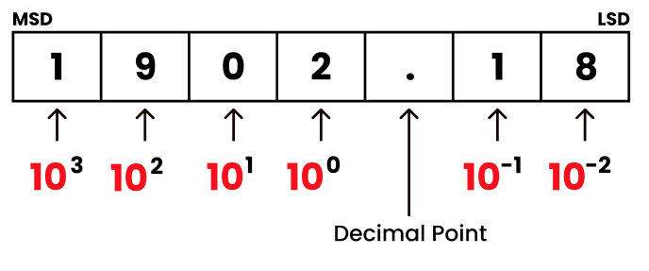
- Decimal Number system
Eg : (1902 . 18)
Position Representation
10

Slide 14
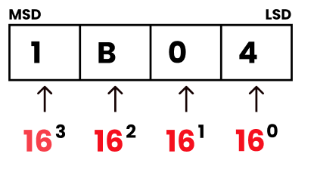
- Hexadecimal Number system
Base : 16
Symbols : 0 1 2 3 4 5 6 7 8 9 A B C D E F
Eg : (1B04)
Position Representation
16

Slide 15
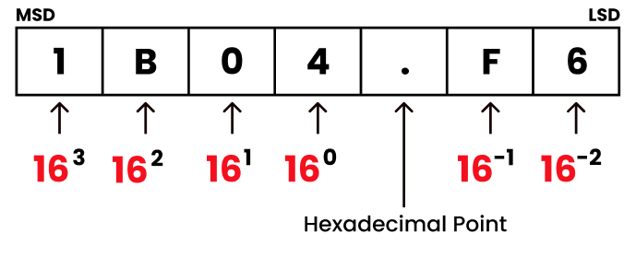
- Hexadecimal Number system
Eg : (1B04 . F6)
Position Representation
16

Slide 16
Number Conversion
Convert one number system to another number system

Slide 17
Binary to Decimal
Octal to Decimal
Hexadecimal to Decimal
Decimal to Binary
Decimal to Octal
Decimal to Hexadecimal
Octal to Binary
Hexadecimal to Binary
Binary to Octal
Binary to Hexadecimal
Octal to Hexadecimal
Hexadecimal to Octal

Slide 19
Binary to Decimal
Octal to Decimal
Hexadecimal to Decimal
( )
2
( )
8
( )
10
- Multiplication Method
( )
16

Slide 20
Decimal to Binary
Decimal to Octal
Decimal to Hexadecimal
( )
2
( )
8
( )
10
- Repeated Division Method
( )
16

Slide 21
Octal to Binary
Hexadecimal to Binary
( )
8
( )
2
- Conversion Method
( )
16

Slide 22
Binary to Octal
Binary to Hexadecimal
( )
8
( )
2
- Grouping Method
( )
16

Slide 23
Octal to Hexadecimal
Hexadecimal to Octal
( )
8
( )
2
( )
16
Covert to Binary
then Binary to Number system
( )
8
( )
2
( )
16

Slide 24
Number Conversion Lets Starts…

Slide 25
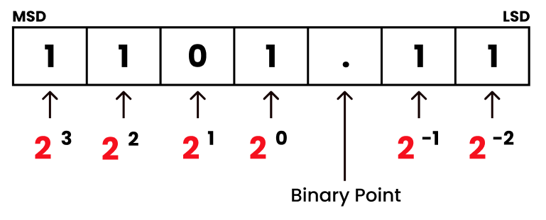
- Binary to Decimal Conversion
Multiply each bits by its positional value and add
Eg : convert (1101.11) to Decimal.
Position Representation
2

Slide 26
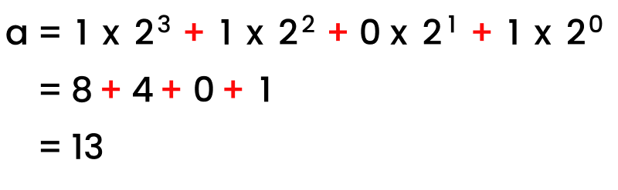
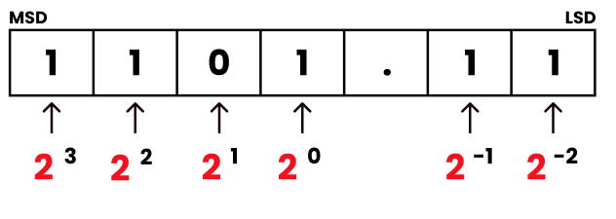
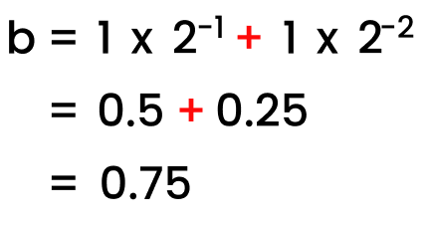
- Binary to Decimal Conversion
a
b
(1101.11) = (13.75)
2
10

Slide 28
- Octal to Decimal Conversion
Multiply each octal digit by its positional value and add
Eg : convert (256.11) to Decimal.
Position Representation
8
2
5
6
.
1
1
2
1
0
-1
-2
8
8
8
8
8
Octal Point

Slide 29
- Octal to Decimal Conversion
2
+
1
+
0
a
=
2 x 8
5 x 8
6 x 8
2
5
6
.
1
1
+
9
=
64
40
+
2
1
0
-1
-2
=
113
8
8
8
8
8
b
-1
-2
a
b
=
1 x 8
+
1 x 8
= 0.125 + 0.0156
= 0.1406
(256.11) = (113.1406)
10
8

Slide 31
- Hexadecimal to Decimal Conversion
Multiply each hexadecimal digit by its positional value and add
Eg : convert (3A6.13) to Decimal.
Position Representation
16
3
A
6
.
1
3
2
1
0
-1
-2
16
16
16
16
16
Hexadecimal Point

Slide 32
- Hexadecimal to Decimal Conversion
2
1
0
a = 3 x 16 + (10) x 16 + 6 x 16
3
A
6
.
1
3
= 768 + 160 + 6
2
1
0
-1
-2
=
934
16
16
16
16
16
b
-1
-2
a
b
=
1 x 16
+
3 x 16
= 0.0625 + 0.004
= 0.0665
(256.11) = (934.0665)
10
16

Slide 34
- Decimal to Binary Conversion
Repeatedly dividing it by 2, until the quotient is zero
Reminder generate each division form binary number
Eg : convert (25 . 28) to Binary.
Position Representation
10
2
5
.
2
8
1
0
-1
-2
10
10
10
10
Decimal Point

Slide 35
- Decimal to Binary Conversion
2 25
LSB
A
2
5
.
2
8
2 12 1
1
0
-1
-2
10
10
10
10
2 6 0
2 3 0
A
B
2 1 1
0 1
MSB
A = 11001

Slide 36
- Decimal to Binary Conversion
Fractional part conversion by multiply with 2
2
5
.
2
8
B
0.28 x 2 = 0.56 0
MSB
1
0
-1
-2
10
10
10
10
0.56 x 2 = 1.12 1
A
B
0.12 x 2 = 0.24 0
0.24 x 2 = 0.48 0
0.48 x 2 = 0.96 0
LSB
B = 01000
(25.28) = (11001.01000)
10
2

Slide 38
- Decimal to Octal Conversion
Repeatedly dividing it by 8, until the quotient is zero
Reminder generate each division form Octal number
Eg : convert (163 . 253) to Octal.
Position Representation
10
1
6
3
.
2
5
3
2
1
0
-1
-2
-3
10
10
10
10
10
10
Decimal Point

Slide 39
- Decimal to Octal Conversion
8 163
LSB
A
1
6
3
.
2
5
3
8 20 3
8 2 4
2
1
0
-1
-2
-3
10
10
10
10
10
10
8 0 2
MSB
A
B
A = 243

Slide 40
- Decimal to Octal Conversion
Fractional part conversion by multiply with 8
1
6
3
.
2
5
3
B
0.253 x 8 = 2.024 2
MSB
2
1
0
-1
-2
-3
10
10
10
10
10
10
0.024 x 8 = 0.192 0
0.192 x 8 = 1.536 1
A
B
0.536 x 8 = 4.288 4
0.288 x 8 = 2.304 2
LSB
B = 20142
(163.253) = (243 . 20142 )
10
8

Slide 42
- Decimal to Hexadecimal Conversion
Repeatedly dividing it by 16, until the quotient is zero
Reminder generate each division form Hexadecimal number
Eg : convert (298 . 653) to Octal.
Position Representation
10
2
9
8
.
6
5
3
2
1
0
-1
-2
-3
10
10
10
10
10
10
Decimal Point

Slide 43
- Decimal to Hexadecimal Conversion
A
16 298
LSB
2
9
8
.
6
5
3
16 18 10
16 1 2
2
1
0
-1
-2
-3
10
10
10
10
10
10
0 1
MSB
A
B
A = 12 (10)
= 12 A

Slide 44
- Decimal to Hexadecimal Conversion
Fractional part conversion by multiply with 16
2
9
8
.
6
5
3
B
MSB
0.653 x 16 = 10.448 10
2
1
0
-1
-2
-3
10
10
10
10
10
10
0.448 x 16 = 7.168 7
0.168 x 16 = 2.668 2
A
B
0.668 x 16 = 11.008 11
LSB
B = (10) 7 2 (11)
= A72B
(298 . 653) = (12A . A72B)
10
16

Slide 46
- Octal to Binary Conversion
Covert each Octal digit into its 3 bit binary equivalent
Octal | Binary Equivalent
0 | 000
1 | 001
2 | 010
3 | 011
4 | 100
5 | 101
6 | 110
7 | 111

Slide 47
- Octal to Binary Conversion
Eg : Convert (35 . 10) to Binary
8
A
3 5 . 1 0
3
5
.
1
0
011 101 . 001 000
1
0
-1
-2
B
8
8
8
8
A
B
11 101 . 001
(35.10) = (11101. 001)
10
2

Slide 49
- Hexadecimal to Binary Conversion
Covert each Hexadecimal digit into its 4 bit binary equivalent
Hexadecimal | Binary Equivalent
0 | 0000
1 | 0001
2 | 0010
3 | 0011
4 | 0100
5 | 0101
6 | 0110
7 | 0111
8 | 1000
9 | 1001
A | 1010
B | 1011
C | 1100
D | 1101
E | 1110
F | 1111

Slide 50
- Hexadecimal to Binary Conversion
Eg : Convert (6A . 21) to Binary
16
A
6 A . 2 1
6
A
.
2
1
0110 1010 . 0010 0001
1
0
-1
-2
B
16
16
16
16
A
B
110 1010 . 0010 0001
(6A.21) = (1101010 . 00100001)
16
2

Slide 52
- Binary to Octal Conversion
Covert 3 bit Binary number into corresponding Octal equivalent
Binary | Octal Equivalent
000 | 0
001 | 1
010 | 2
011 | 3
100 | 4
101 | 5
110 | 6
111 | 7

Slide 53
- Binary to Octal Conversion
Eg : Convert (1100110 . 01) to Octal
2
1 100 110 . 01
001 100 110 . 010
1 4 6 . 2
(1100110 . 01) = (146. 2)
2
8

Slide 55
- Binary to Hexadecimal Conversion
Covert 3 bit Binary number into corresponding Octal equivalent
Binary | Hexadecimal Equivalent
0000 | 0
0001 | 1
0010 | 2
0011 | 3
0100 | 4
0101 | 5
0110 | 6
0111 | 7
1000 | 8
1001 | 9
1010 | A
1011 | B
1100 | C
1101 | D
1110 | E
1111 | F

Slide 56
- Binary to Hexadecimal Conversion
Eg : Convert (1100110 . 01) to Hexadecimal
2
110 0110 . 01
0110 0110 . 0100
6 6 . 4
(1100110 . 01) = (66 . 4)
2
16

Slide 58
- Octal to Hexadecimal Conversion
Convert octal number into equivalent binary,
then convert binary to hexadecimal
Eg : Convert (67. 4) to Hexadecimal
8
Octal to Binary
Binary to Hexadecimal
11 0111 . 100
6 7 . 4
0011 0111 . 1000
110 111 . 100
3 7 . 8
(67.4) = (37.8)
8
16

Slide 60
- Hexadecimal to Octal Conversion
Convert Hexadecimal number into equivalent binary,
then convert binary to Octal
Eg : Convert (B6. F) to Octal
16
Hexadecimal to Binary
Binary to Octal
10 110 110 . 111 1
B 6 . F
010 110 110 . 111 100
1011 0110 . 1111
2 6 6 . 7 4
(B6.F) = (266.74)
16
8

Slide 62
Binary Arithmetic

Slide 63
Binary Addition
Binary Subtraction

Slide 64
- Binary Addition
Carry bit 1 is created only two 1s are added
Three 1s are added ,then sum is 1 and carry is 1
A | B | Sum | Carry
0 | 0 | 0 | 0
0 | 1 | 1 | 0
1 | 0 | 1 | 0
1 | 1 | 0 | 1
0 +
0
0 +
1
0
1
1 +
1
1
1 +
0
1 +
1
11
1
10

Slide 65
Eg : Find sum of binary numbers 1011 and 1001
1 1
1 0 1 1 +
1 0 0 1
1 0 1 0 0

Slide 66
Eg : Find sum of binary numbers 110111 and 111
1 1 1
1 1 0 1 1 1 +
1 1 1
1 1 1 1 1 0

Slide 68
- Binary Subtraction
Borrow bit 1 is created only 1 subtracted from 0
A | B | Difference | Borrow
0 | 0 | 0 | 0
0 | 1 | 1 | 1
1 | 0 | 1 | 0
1 | 1 | 0 | 0

Slide 69
Eg : Subtract 10101 from 11111
1 1 1 1 1 -
1 0 1 0 1
0 1 0 1 0

Slide 70
Eg : Subtract 011 from 101
0 2
1 0 1 -
0 1 1
5 -
3
0 1 0
2

Slide 71
Eg : Subtract 10111 from 101000
1 2
1 2
0 2
0 2
1 0 1 0 0 0 -
1 0 1 1 1
0 1 0 0 0 1

Slide 73
Representation of Numbers

Slide 74
Numbers or integers represented in computer are
Sign and Magnitude Representation ( SM )
1’s Compliment Representation
2’s Compliment Representation

Slide 75
- Sign and Magnitude Representation
It is used to represent signed numbers
It consist of sign part and magnitude part
Example : - 32 +51 - 7
A Computer word size is 1 byte (8 bit)
The 7th bit (MSD) is used for representing sign of a number
Sign Part
Magnitude Part
MSD
LSD
0
0
0
0
0
0
0
0
Sign
Magnitude

Slide 76
If 7th bit is Zero , it indicate the number is +ve
If 7th bit is One , it indicate the number is -ve
0
0
0
0
0
1
0
1
1
0
0
0
0
1
0
1
+
5
-
5
+5
-5

Slide 78
- 1’s Compliment Representation
Another method of representing Negative numbers
-ve number indicate its compliment
0
0
0
0
0
1
0
1
+5
1’s Compliment
1
1
1
1
1
0
1
0
-5

Slide 80
- 2’s Compliment Representation
Another method of representing Negative numbers
Just add 1 with 1’s compliment
0
0
0
0
0
1
0
1
+5
1’s Compliment
1
1
1
1
1
0
1
0
1
2’s Compliment
1
1
1
1
1
0
1
1
-5

Slide 82
Representation of Characters

Slide 83
Symbolic way to represent characters in computers are called character representation
ASCII
EBCDIC
ISCII
Unicode

Slide 84
ASCII
ASCII
American Standard Code for Information interchange
Use 7 bit to represent a character
Example : A 97 ( 1 1 0 0 0 0 1 )
It can represent 128 characters
2 = 128
7

Slide 85
EBCDIC
EBCDIC
Extended Binary Coded Decimal Interchange Code
Similar to ASCII
Use 8 bit to represent a character
It can represent 256 characters
2 = 256
8

Slide 86
ISCII
ISCII
Indian Standard Code for Information Interchange
Or Indian Script Code for Information Interchange
Use 8 bit to represent a character
It can be used to represent various writing system of india

Slide 87
Unicode
Unicode
16 bit Code represent up to 65,536 characters
Used to represent almost all written languages of the world
Now a days Unicode represent more than 16 bit codes

Slide 89
Boolean Algebra

Slide 90
Boolean Algebra
Boolean algebra is a form of mathematics that deals with statements and their values.
It can have only two values: true or false. ( 0 or 1 )
The operation performed by Boolean values are called Boolean operations / logical operations
Logical gate : physical device that perform logical operations
It is implemented using diodes and transistors

Slide 91
Boolean Operations and logical gates
3 basic Boolean operations in Boolean algebra
OR → Logical Addition
AND → Logical Multiplication
NOT → Logical Negation

Slide 92
Logical OR
OR operation performs logical addition
+ Plus symbol used for this operation
A + B read as A OR B
Truth table : ( All possible operations and results )
Input A | Input B | Y = A + B (A OR B)
0 | 0 | 0
0 | 1 | 1
1 | 0 | 1
1 | 1 | 1

Slide 93
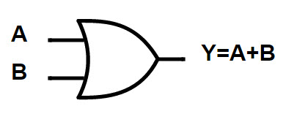
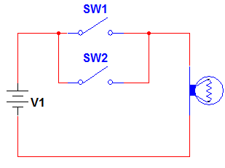
OR Gate
OR Gate Circuit
“ If any one of the input is true, the total output is true ”

Slide 94
Logical AND
AND operation performs logical Multiplication
. Dot symbol used for this operation
A . B read as A AND B
Truth table : ( All possible operations and results )
Input A | Input B | Y = A . B (A AND B)
0 | 0 | 0
0 | 1 | 0
1 | 0 | 0
1 | 1 | 1

Slide 95
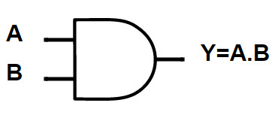
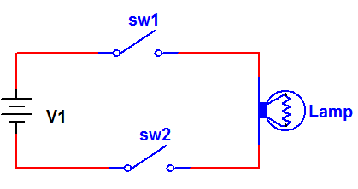
OR Gate
OR Gate Circuit
“ If both of the input is true, the total output is true ”

Slide 96
Logical NOT
NOT operation performs logical Nagation
over bar symbol used for this operation
A read as A NOT
Truth table : ( All possible operations and results )
Input A | Y = A
0 | 1
1 | 0
Also called inverter

Slide 97
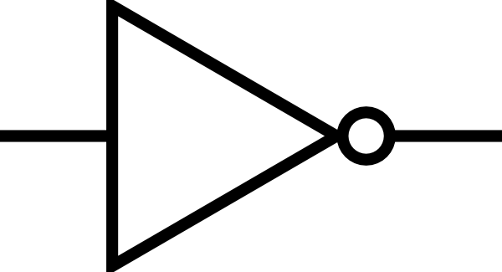
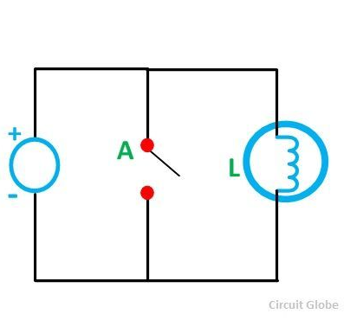
OR Gate
OR Gate Circuit
A
Y = A
“ output give the complement of input”

Slide 99
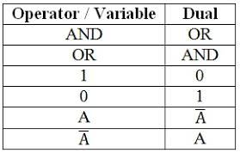
Principle of Duality
A Boolean relation can be written to another Boolean relation by changing each OR operation to AND operation vice versa
Example : A ( B + C ) = AB . AC
If the statement is true for an expression, then it is also true for the dual of the expression

Slide 101
Basic theorems of Boolean Algebra
Standard and accepted rules in Boolean algebra
The rules are known as axioms
Identity law
Idempotent law
Involution law
Complimentary law
Commutative law
Associative law
Distributive law
Absorption law

Slide 102
Identity law
0 + x = x 1 + x = 1
Additive identity
Multiplicative identity
0 + 0 = 0 1 + 0 = 1
0 + x = x 1 + x = 1
0 + 1 = 1 1 + 1 = 1
0 . x = 0 1 . x = x
0 . x = 0 1 . x = x
0 . 0 = 0 1 . 0 = 0
0 . 1 = 0 1 . 1 = 1

Slide 103
Idempotent law
if x = 0 ,
if x = 1 ,
x + x = x
x + x = x
0 + 0 = 0
1 + 1 = 1
x + x = x
x . x = x
if x = 0 ,
if x = 1 ,
x . x = x
x . x = x
0 . 0 = 0
1 . 1 = 1

Slide 104
Involution law
if x = 0 ,
if x = 1 ,
X = X
X = X
X = X
0 = 1
1 = 0
0 = 0
1 = 1

Slide 105
Complimentary law
if x = 0 ,
if x = 1 ,
x + x = 1
x + x = 1
X + X = 1
0 + 0
1 + 1
1 + 0 = 1
0 + 1 = 1
if x = 0 ,
if x = 1 ,
X . X = 0
x . x = 0
x . x = 0
0 . 0
1 . 1
1 . 0 = 0
0 . 1 = 0

Slide 106
Commutative law
X | Y | X + Y | Y + X
0 | 0 | 0 | 0
0 | 1 | 1 | 1
1 | 0 | 1 | 1
1 | 1 | 1 | 1
x + y = y + x
X | Y | X . Y | Y . X
0 | 0 | 0 | 0
0 | 1 | 0 | 0
1 | 0 | 0 | 0
1 | 1 | 1 | 1
x . y = y . x

Slide 107
Associative law
x + ( y + z ) = ( x + y ) + z
x . ( y . z ) = ( x . y ) . z

Slide 108
x + ( y + z ) = ( x + y ) + z
X | Y | Z | Y + Z | X + (Y + Z) | X + Y | (X + Y) + Z
0 | 0 | 0 | 0 | 0 | 0 | 0
0 | 0 | 1 | 1 | 1 | 0 | 1
0 | 1 | 0 | 1 | 1 | 1 | 1
0 | 1 | 1 | 1 | 1 | 1 | 1
1 | 0 | 0 | 0 | 1 | 1 | 1
1 | 0 | 1 | 1 | 1 | 1 | 1
1 | 1 | 0 | 1 | 1 | 1 | 1
1 | 1 | 1 | 1 | 1 | 1 | 1

Slide 109
x . ( y . z ) = ( x . y ) . z
X | Y | Z | Y . Z | X . (Y . Z) | X . Y | (X . Y) . Z
0 | 0 | 0 | 0 | 0 | 0 | 0
0 | 0 | 1 | 0 | 0 | 0 | 0
0 | 1 | 0 | 0 | 0 | 0 | 0
0 | 1 | 1 | 1 | 0 | 0 | 0
1 | 0 | 0 | 0 | 0 | 0 | 0
1 | 0 | 1 | 0 | 0 | 0 | 0
1 | 1 | 0 | 0 | 0 | 1 | 0
1 | 1 | 1 | 1 | 1 | 1 | 1

Slide 110
Distributive law
x . ( y + z ) = ( x . y ) + ( x . z )
x + ( y . z ) = ( x + y ) . ( x + z )

Slide 111
x . ( y + z ) = ( x . y ) + ( x . z )
X | Y | Z | Y + Z | X . (Y + Z) | X . Y | X . Z | (X . Y) + ( X . Z )
0 | 0 | 0 | 0 | 0 | 0 | 0 | 0
0 | 0 | 1 | 1 | 0 | 0 | 0 | 0
0 | 1 | 0 | 1 | 0 | 0 | 0 | 0
0 | 1 | 1 | 1 | 0 | 0 | 0 | 0
1 | 0 | 0 | 0 | 0 | 0 | 0 | 0
1 | 0 | 1 | 1 | 1 | 0 | 1 | 1
1 | 1 | 0 | 1 | 1 | 1 | 0 | 1
1 | 1 | 1 | 1 | 1 | 1 | 1 | 1

Slide 112
x + ( y . z ) = ( x + y ) . ( x + z )
X | Y | Z | Y . Z | X + (Y . Z) | X + Y | X + Z | (X + Y) . ( X + Z )
0 | 0 | 0 | 0 | 0 | 0 | 0 | 0
0 | 0 | 1 | 0 | 0 | 0 | 1 | 0
0 | 1 | 0 | 0 | 0 | 1 | 0 | 0
0 | 1 | 1 | 1 | 1 | 1 | 1 | 1
1 | 0 | 0 | 0 | 1 | 1 | 1 | 1
1 | 0 | 1 | 0 | 1 | 1 | 1 | 1
1 | 1 | 0 | 0 | 1 | 1 | 1 | 1
1 | 1 | 1 | 1 | 1 | 1 | 1 | 1

Slide 113
Absorption law
X | Y | X . Y | X + (Y . X)
0 | 0 | 0 | 0
0 | 1 | 0 | 0
1 | 0 | 0 | 1
1 | 1 | 1 | 1
x + ( x . y ) = x
X | Y | X + Y | X . (Y + X)
0 | 0 | 0 | 0
0 | 1 | 1 | 0
1 | 0 | 1 | 1
1 | 1 | 1 | 1
x . ( x + y ) = x

Slide 115
De Morgan’s theorems

Slide 116
De Morgan's theorems
The Complement of sum of Boolean variable is equal to product of their individual complements.
X + Y = X . Y
The Complement of product of Boolean variable is equal to sum of their individual complements.
X . Y = X + Y

Slide 117
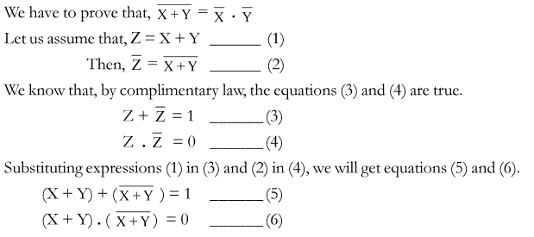

Proof of 1st theorem
X + Y = X . Y
7
8

Slide 118
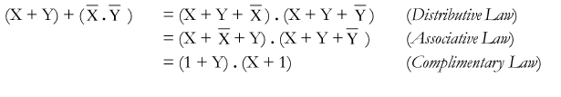


Equation 7 :

Slide 119
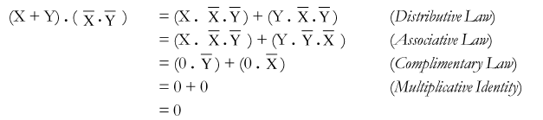
Equation 8 :

Slide 120
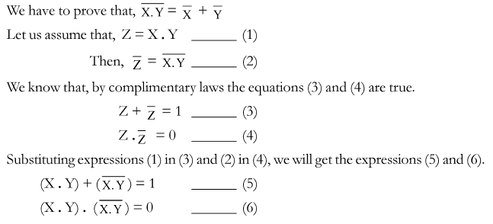

Proof of 2nd theorem
X . Y = X + Y
7
8

Slide 121
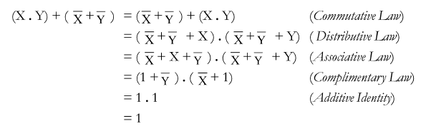

Equation 7 :

Slide 122
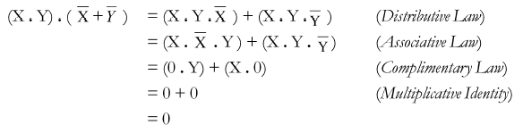

Equation 8 :

Slide 124
Logic Circuits

Slide 125
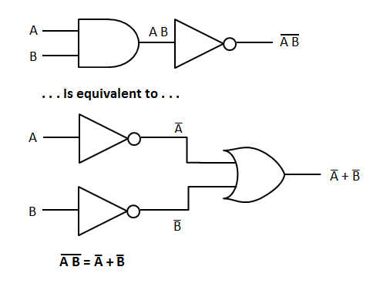

Slide 126
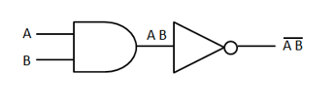
Universal gate
Universal gate is a gate which can implement any other Boolean function without using any other gates
NAND gate and NOR gate are called universal gate.
NAND = Noted AND gate

Slide 127
Universal gate
NOR = Noted OR gate
A
A+B
A
A+B
A+B
B
B

Slide 128
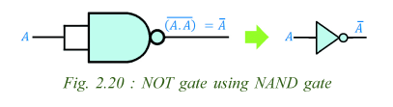
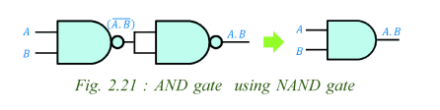
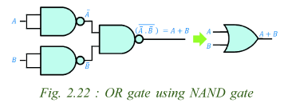

Slide 129

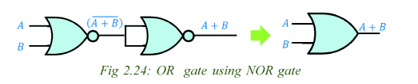
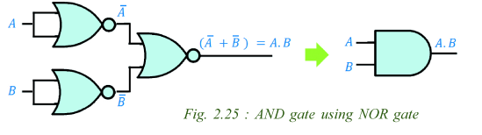

Slide 130
Teaching materials Prepared by
RIDHUN DEV
Lecture IHRD College
+1 / +2 Computer Science
8089552581

